Slide 1
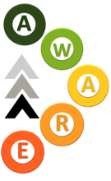
AWARE
Assessment of Wood Attributes using Remote Sensing

Slide 2
Context for the Proposal
Resource assessment in the forest sector is a critical component of sustainable forest management
New technologies and tools are always required to grow improved wood fibre, quantify it and make better management decisions

Slide 3
Canadian Forest Sector
Provincial and Federal forestry agencies also have key stakes in forest management decisions under legislation and for public oversight
As a result industrial companies, provincial and federal agencies have a history of working together to improve forest inventory and Canadian competitiveness

Slide 4
Advanced Remote Sensing
Advanced sensing technologies are a critical piece of improving forest inventory approaches
Light Detection and Ranging (LiDAR), for example, is a relatively new technology which is being actively adopted by forest companies and agencies around the world
Canadian researchers, working closely with the provinces and forest industry, have had a leading role developing and applying LiDAR technology to forestry applications

Slide 5
Industry
University
CFS / Canadian Wood Fiber Centre
Provincial Agencies
In particular the CWFC has led and continues to lead an Enhanced Forest Inventory (EFI) program with
  Federal, provincial and academic researchers and industrial partners to develop methods applicable across Canada.
The program is fully functional and is highly complementary to this proposal.
A key result is a highly educated and receptive forest sector with respect to the use of advanced remote sensing tools.

Slide 6
Advanced Remote Sensing and Canadian Forest Sector
While awareness is high, uptake has been patchy across Canada.
There are challenges compared to other countries implementing these types of tools.
Huge areas, provincial jurisdiction of the strategic inventory.
Ongoing large scale disturbance such as MPB and fire.
Market challenges as a result of distance to mills and market.
Efficiency is critical, and advanced remote sensing costs are now at relatively low levels.
AWARE is well timed to address some of these issues.

Slide 7



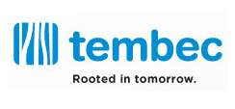




Slide 8








Slide 9




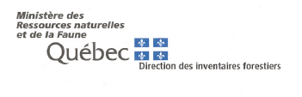


Slide 10

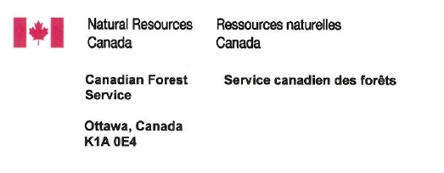

Slide 11
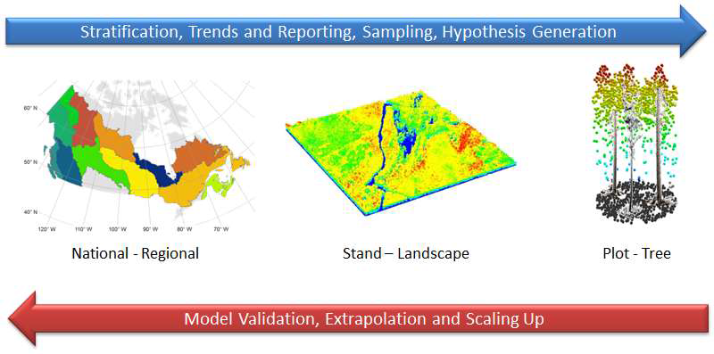
AWARE
Assessment of Wood Attributes using Remote Sensing
Consists of 3 themes, from the broad to fine spatial scales; and a cross cutting theme which includes topics relevant to all themes, or to all companies.

Slide 12
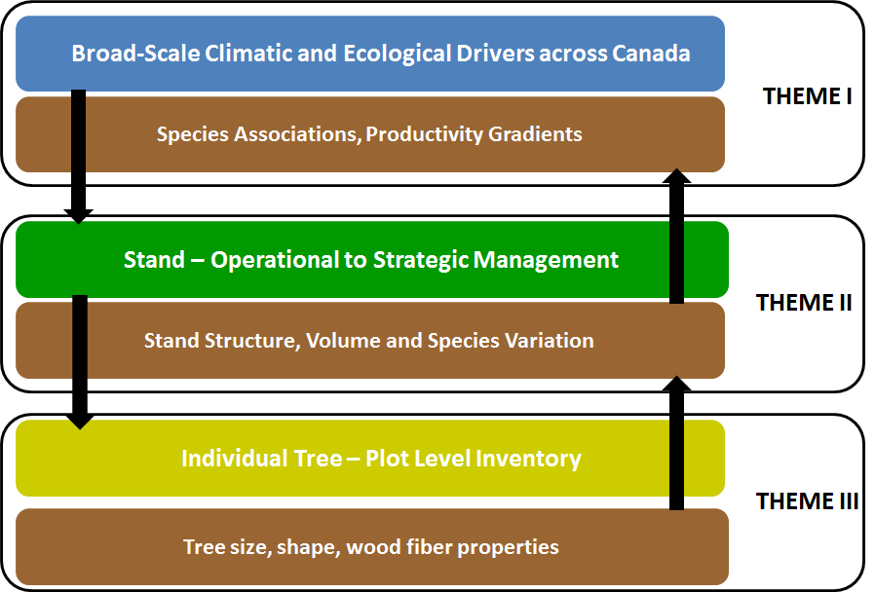

Slide 13
Theme Leaders
Theme 1: Coops
Theme 2: Coops / Fournier
Theme 3: Fournier
Cross Cutting Theme: St-Onge
Each theme has a number of focus areas

Slide 14
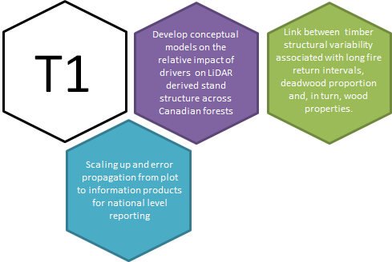
Structural Variability and Wood Properties
Sampling Approaches for Regional Level Reporting
Ecological Drivers / Implications for Management
Theme 1: What is the relative impact of ecological drivers such as disturbance, productivity, management
practices, and species composition on broad-scale variations in stand structure and wood properties
across Canadian forests and how can these be scaled up regionally ?
Project colors correspond to themes

Slide 15
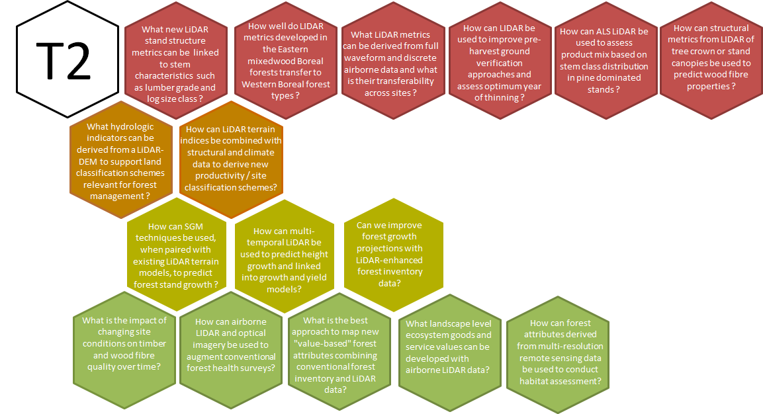
New Structural Metrics for Forest Stand Descriptions
Predictive Modeling for ecological site classification, habitat and forest health
Hydrological Mapping and Productivity
Growth Rate
Theme 2: How can advanced remote sensing technologies improve stand-level attribute estimation for strategic forest management?

Slide 16
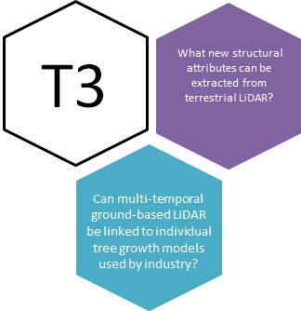
Tree Attribute Extraction and Metrics
Growth Assessment using single date, and multi-temporal ground-based LiDAR scans
Theme 3: What individual tree attributes can be accurately measured from ground-based LiDAR and how can this data be used to scale-up and validate stand level assessments?

Slide 17
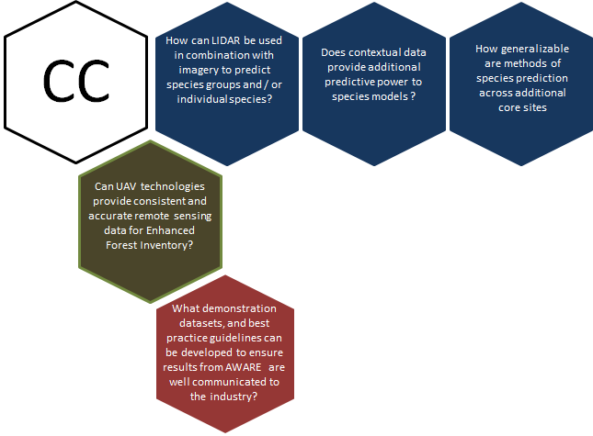
Species Assessment
Best Practice / Tools / Decision Support
Data Acquisition Program and Platforms
Cross-Cutting Theme: Data Acquisition, Modelling, Standards, and Development of Generic Transferable Tools

Slide 18
Core Research Sites
Core Site | Location | Species Mix | Province | Industrial Partner | Lead University | Lead Researcher
1 | Corner Brook Forest | Spruce, fir | Newfoundland and Labrador | Corner Brook Pulp and Paper Limited | Sherbrooke | Fournier
2 | Black Brook Forest | Plantation Spruce, Acadian mixedwood, tolerant hardwood | New Brunswick | JD Irving Limited | UNB / UBC | Arp / MacLean
3 | Hearst/ Romeo Malette / Petawawa Forests | Spruce, Pine, Aspen, Boreal mixedwood | Ontario | Tembec / Lecours Lumber/ Columbia Forest Products | Queens | Treitz
4 | Hinton / Slave Lake Forest | Pine, Spruce, Fir, Boreal mixedwood | Alberta | West Fraser | UBC | Coops

Slide 19
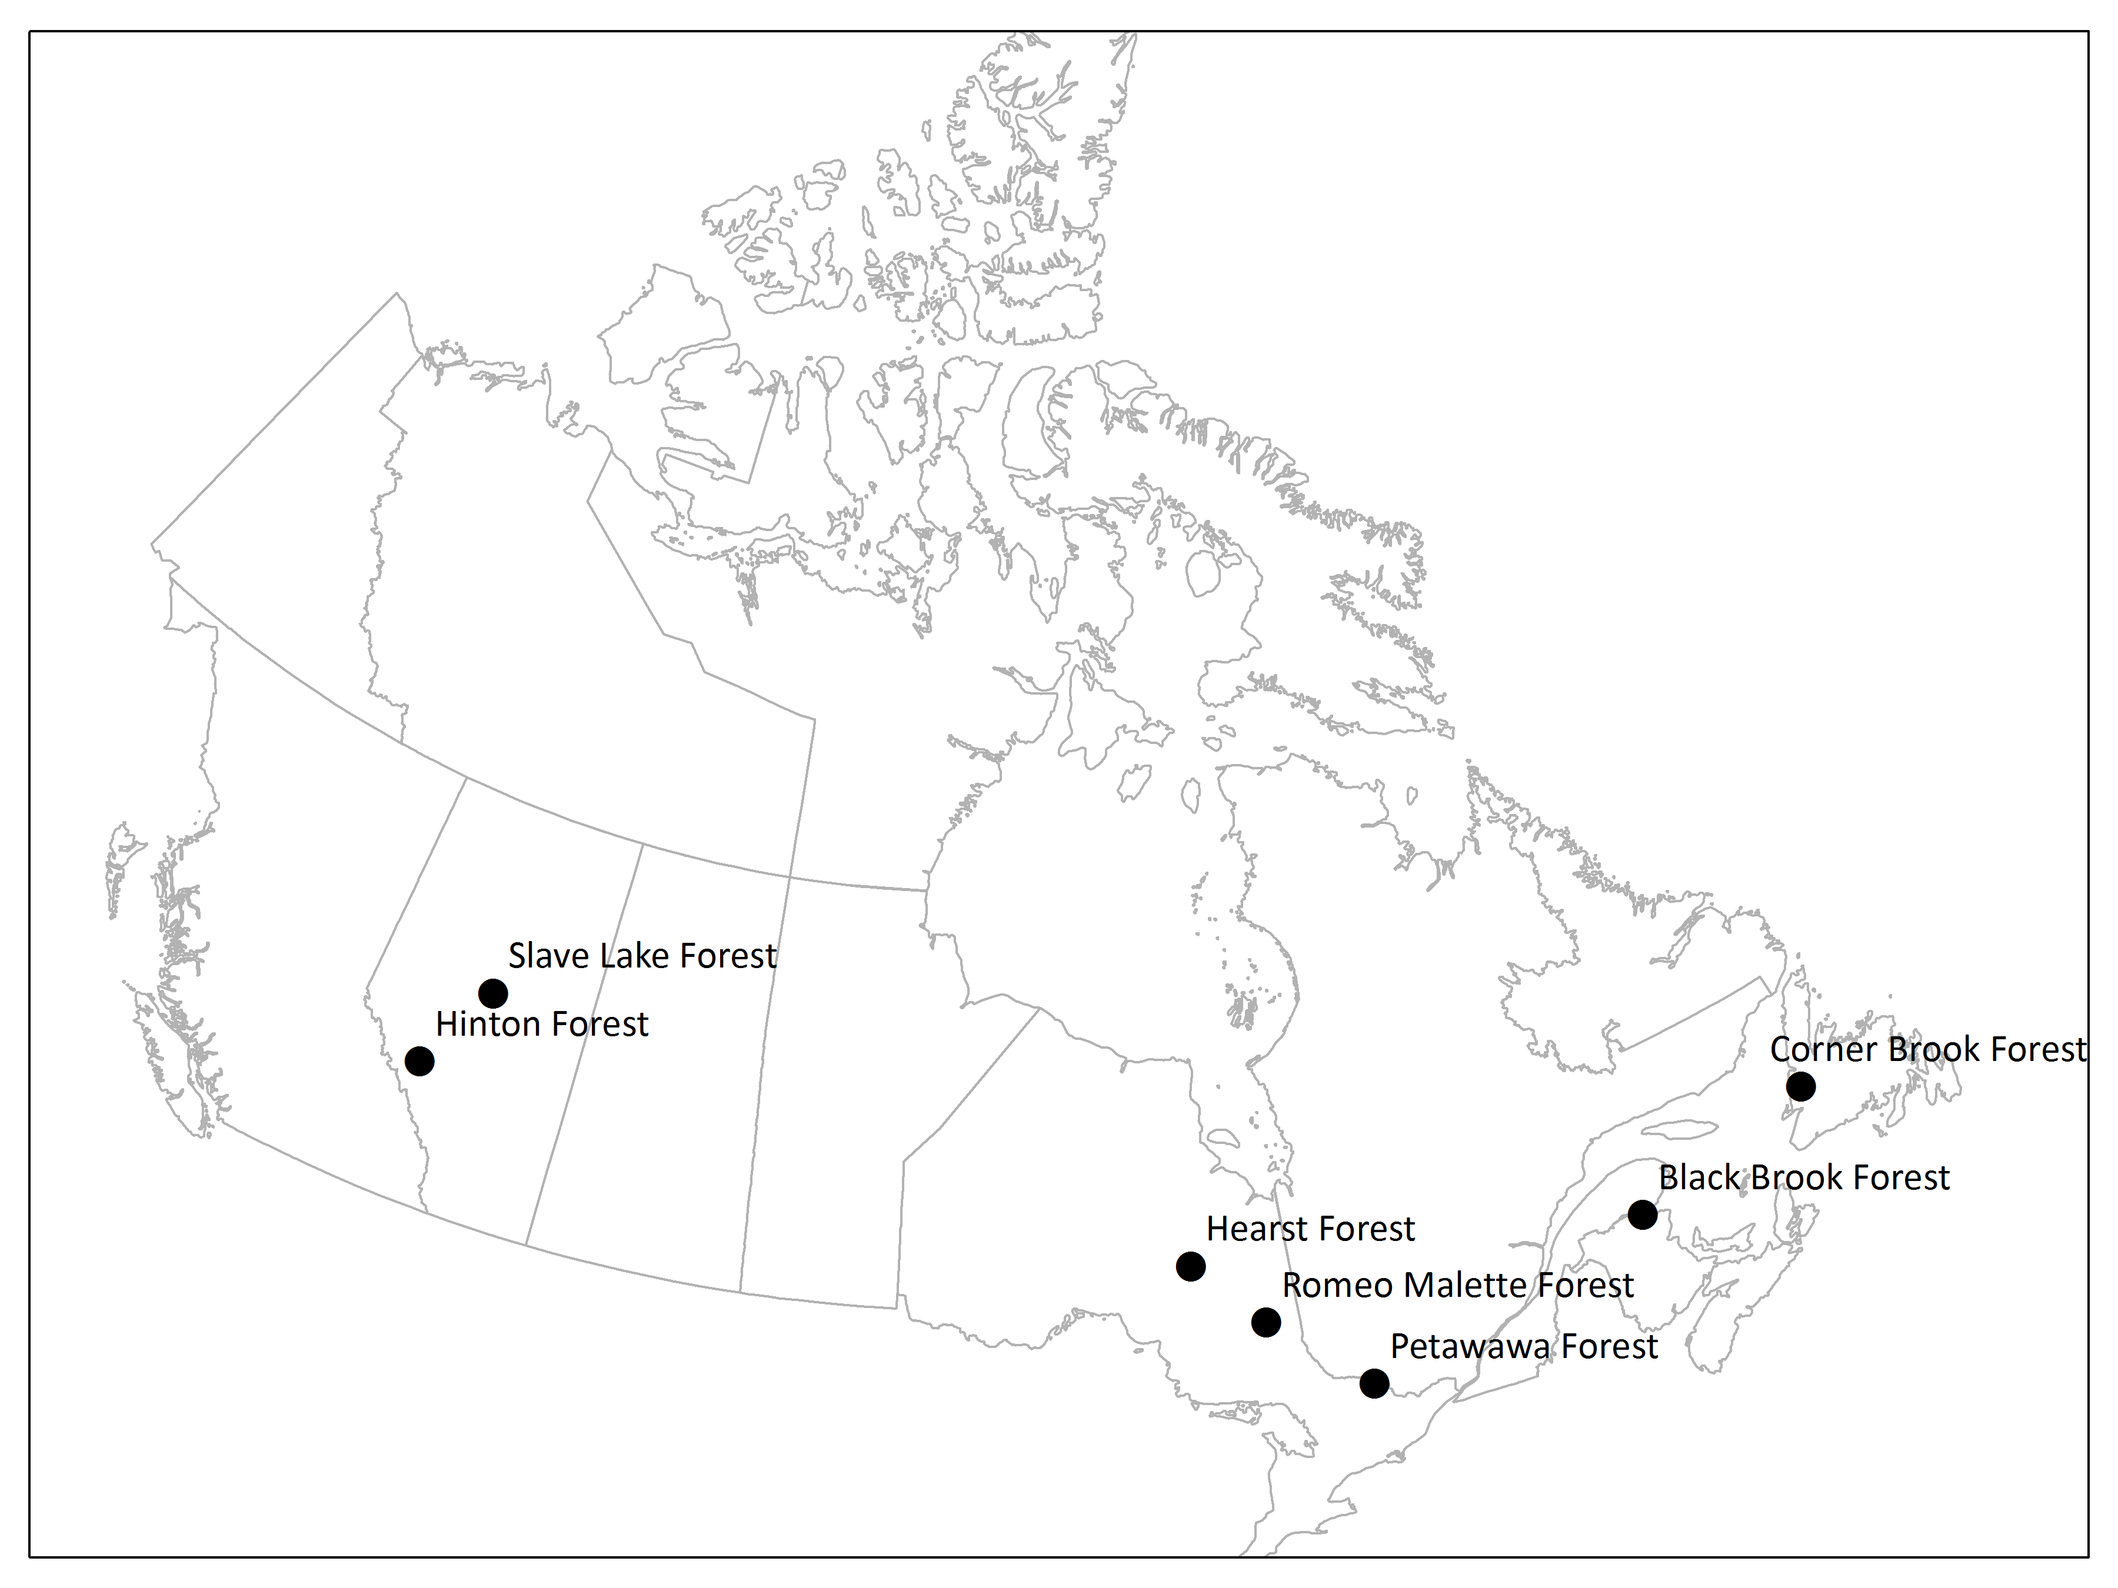

Slide 20
Large Number of HQP
Meet NSERC goal of producing HQP for Canadian industry
AWARE will support 25 HQP over life of project
Anticipated many of the HQP will work in forest industry after completing

Slide 21
Three Key Benefits of a National Approach
AWARE
Assessment of Wood Attributes using Remote Sensing

Slide 22
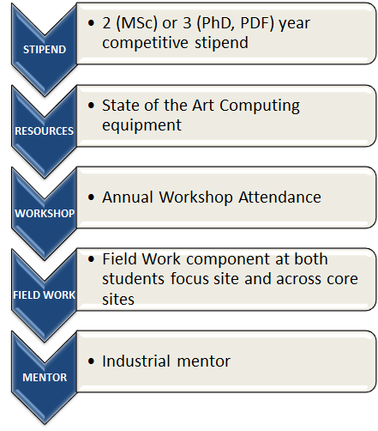
1. Well Supported HQP Across the Country

Slide 23
2. Annual Project Meetings
Five annual meetings planned
Will move around the country to ensure maximum participation and exposure
Bring together industrial partners, HQP, and researchers
Federal and Provincial researchers will also participate
Two broader meetings for the entire Canadian Forestry Industry will also be held

Slide 24
3. Development and Promotion of National Approaches
Development and training on common algorithms and approaches
Common field methods (as appropriate)
Common training of HQP on the relevant issues
Issues relevant across Canada addressed more comprehensively

Slide 25
Meeting Sector Needs
Increased understanding of the value of LiDAR and other promising remote sensing technologies for EFI
Improved estimation of stem distributions, log / piece size, and lumber grade
Prediction of growth using LIDAR in combination with SGM
Site condition assessment and links to wood properties
Linking of LIDAR to silvicultural prescriptions
Forest Health assessment from LIDAR and other optical data
Species assessment from LiDAR
Methods and accuracy of tree growth using ground-based LIDAR
Use of LIDAR for habitat: relevant for woodland caribou and other species of concern

